Slide 1
Learning First; Tools Last: Curriculum-Based Planning with Technology
Mark Hofer & Judi Harris
College of William & Mary

Slide 2
Learning First; Tools Last: Curriculum-Based Planning with Technology
Module 2
The Learning Activity Types (LATs) Approach

Slide 3
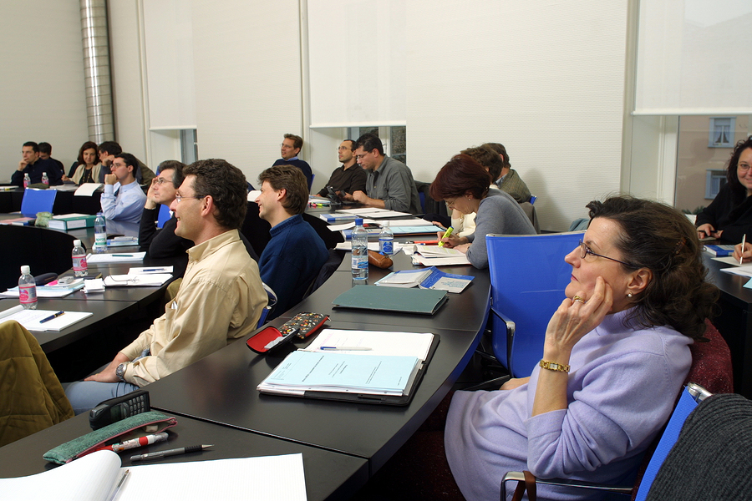
“Problem solving skills improved…”

Slide 4
“Problem solving skills improved…”

Slide 7
Was it worth it?

Slide 8
Technologies

Slide 9
Technologies

Slide 10
Curriculum
Technologies

Slide 11
Curriculum
Technologies

Slide 12
Curriculum
Pedagogy
Technologies

Slide 13
Curriculum
Pedagogy
Technologies

Slide 15
TPACK

Slide 16
TPACK
?
Pedagogy
Content
Technology
Contexts

Slide 18
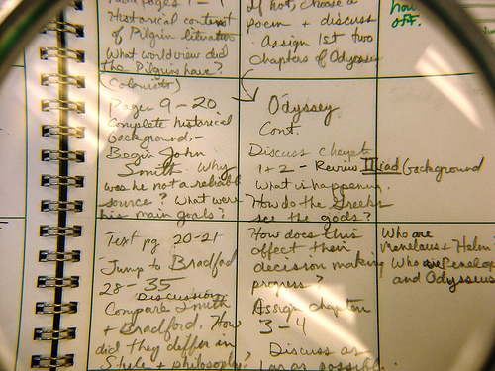
Instructional Planning

Slide 19
Learning goals
Students’ needs/preferences
Learning activities

Slide 20
Learning goals
Students’ needs/preferences
Learning activities

Slide 21
Learning activities

Slide 22
