Slide 1
Instructional Planning with Learning Activity Types
Mark Hofer & Judi Harris
College of William & Mary

Slide 2
Instructional Planning with Learning Activity Types
Module 2
Identify Existing Lessons to Explore

Slide 3
Marquita Hockaday

Slide 4
In this module, you will…
Analyze Examples
Practice with Taxonomies
Plan Your Own
Explore Taxonomies
Select and review three lessons.

Slide 5
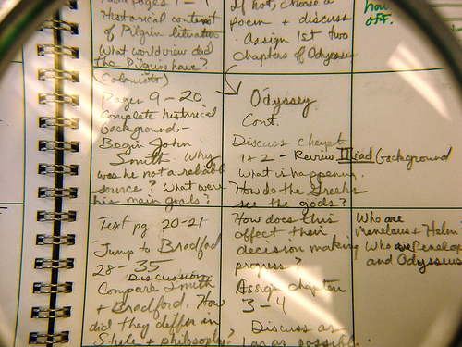
Curated Lesson Plans
LAT
Resources

Slide 6
Look for these features:
interesting
clearly explained
manageable
connected with content
single lessons

Slide 7
Identify the following attributes:
Curriculum focus/standards & learning goals
Learning activities
Assessments of students’ learning
Technologies

Slide 9
Annotate the three lessons.

Slide 10
Save the 3 annotated lessons.

