Slide 2
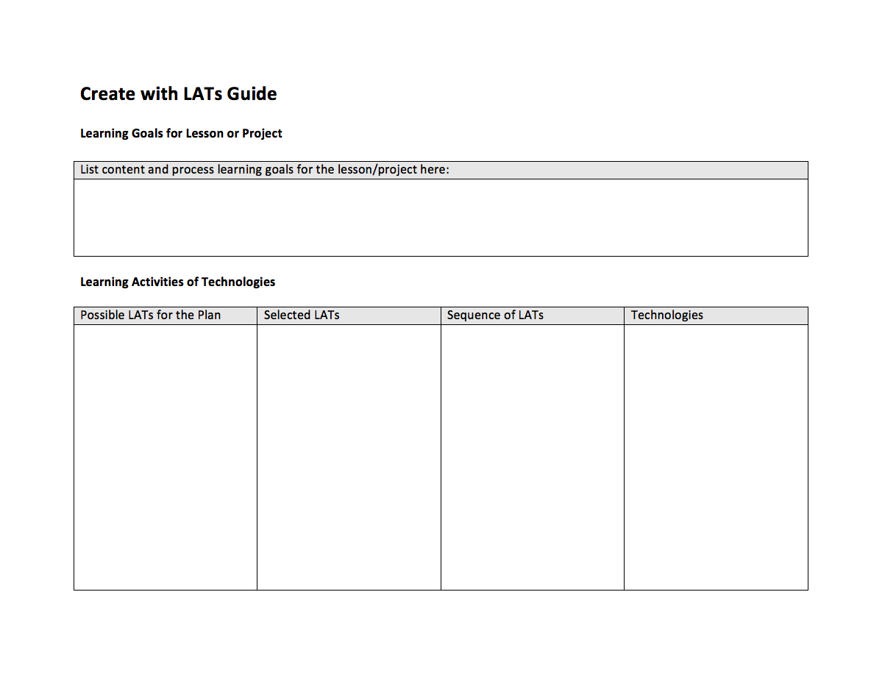

Slide 5
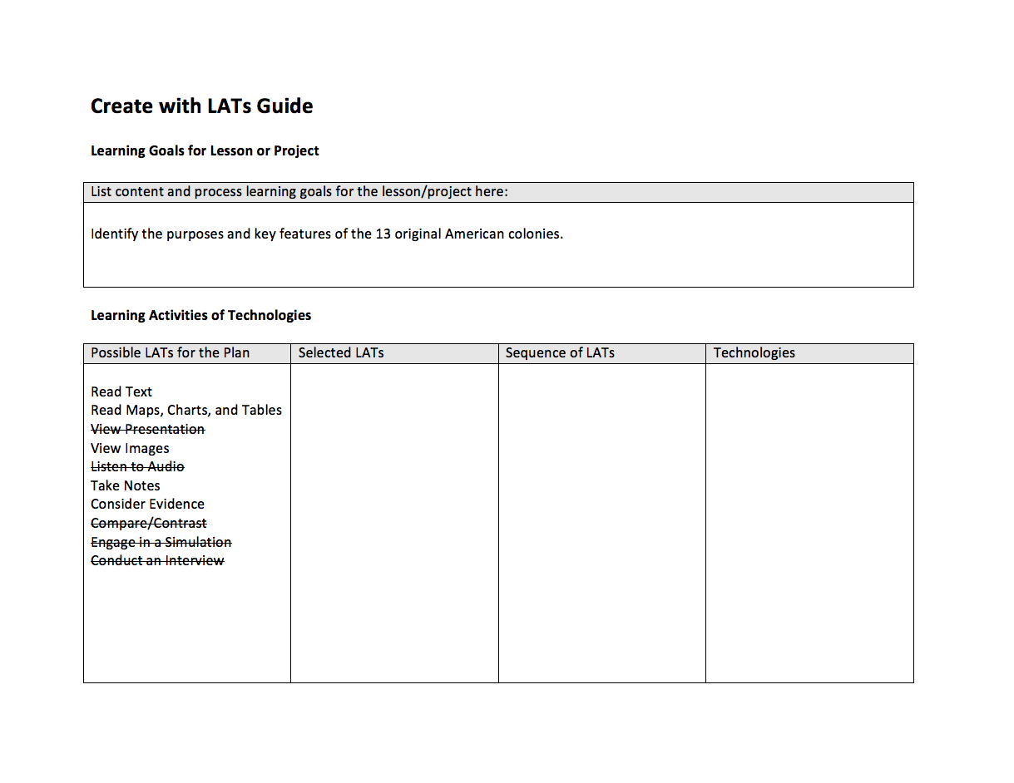

Slide 6
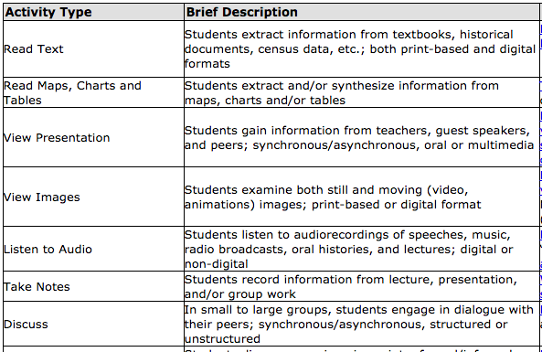
“Identify the purposes and key features
of the 13 original American colonies.”

Slide 7
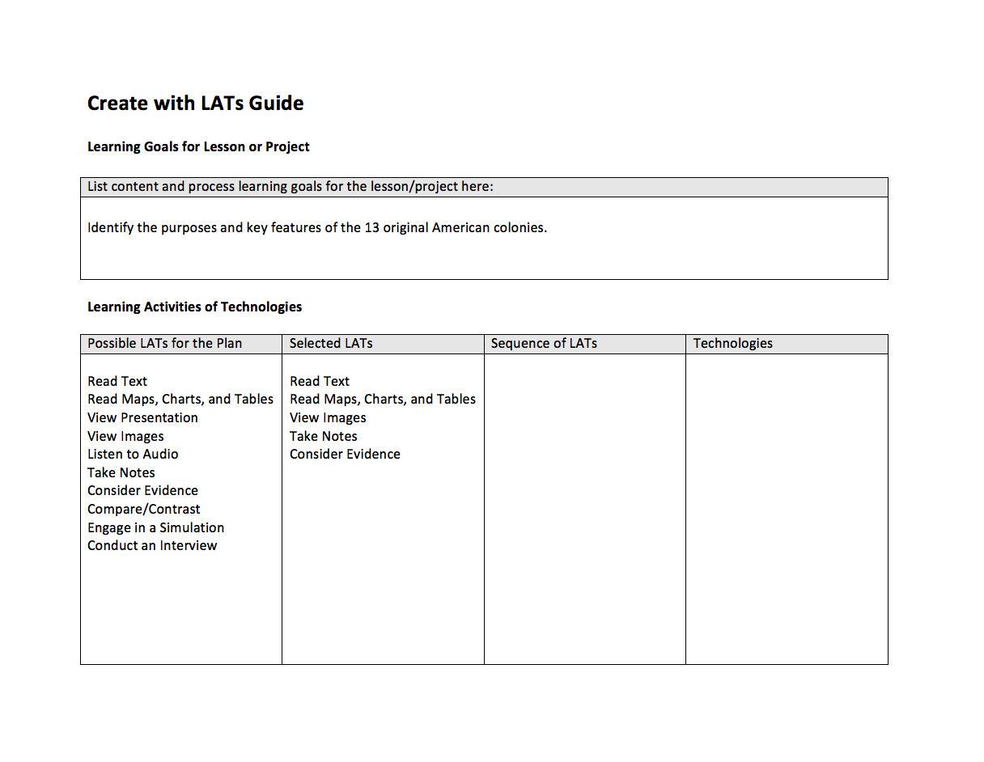

Slide 8
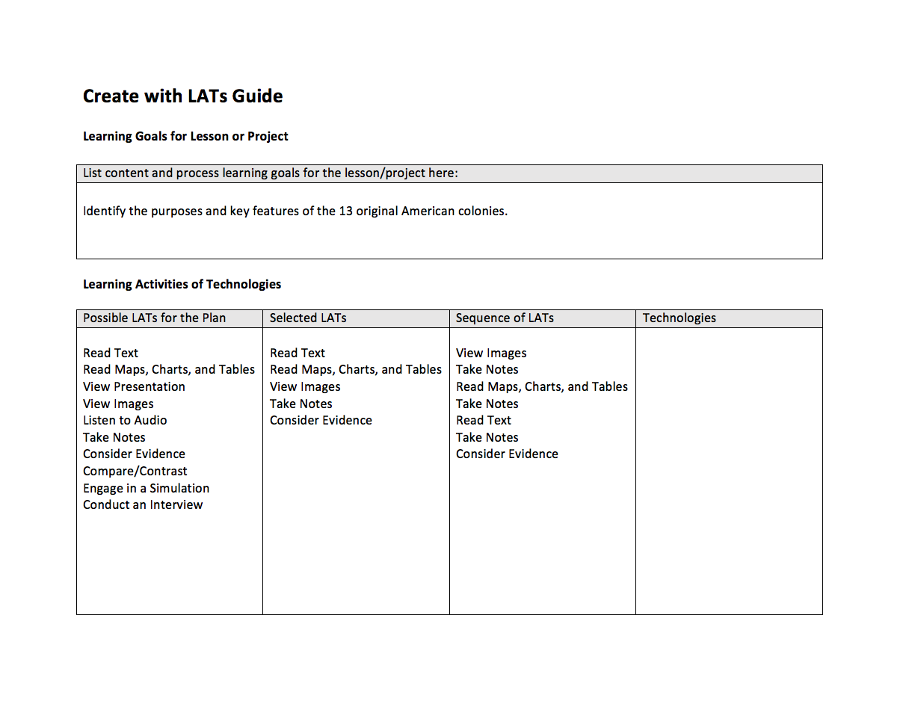

Slide 9
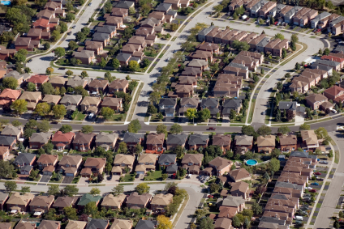
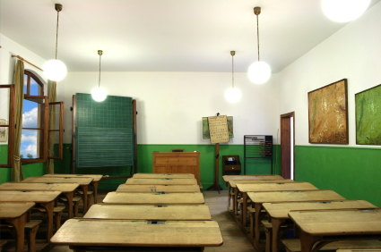
Geography
Neighborhoods
Socioeconomics
District
Expectations
Families
Time
Access
Student
knowledge
Available technologies
Languages
Physical space
Cultural diversity
Interpersonal dynamics
Contexts
Attitudes
Teacher knowledge
Basic needs

Slide 11
