Slide 1
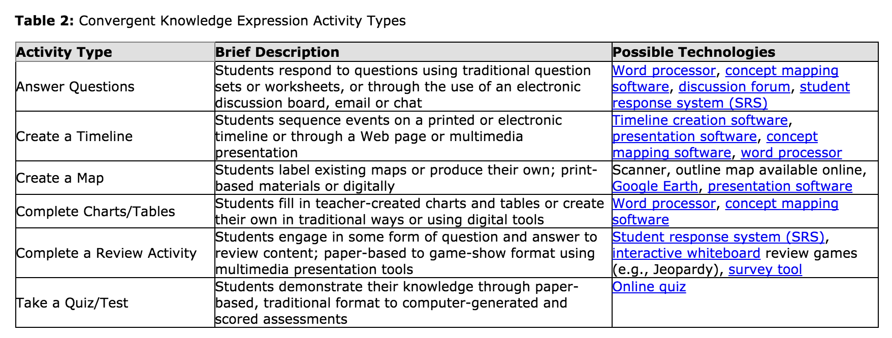
Consider technologies

Slide 3
content
LATs
techs

