Slide 1
Instructional Planning with Learning Activity Types
Mark Hofer & Judi Harris
College of William & Mary

Slide 2
Instructional Planning with Learning Activity Types
Module 1
Introduction

Slide 3
Technology integration isn’t easy

Slide 4
Purpose

Slide 5
Learning Activity Types Approach
Backwards design (Wiggins & McTighe, 2005)
Direct instruction (Hunter, 2004)
Inquiry cycle (Bybee, et. al, 2006)

Slide 6
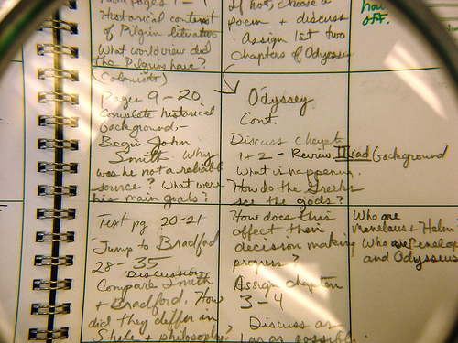
Technology grounded…

Slide 7
http://education.wm.edu

Slide 8
http://creativecommons.org/licenses/by-sa/4.0/

Slide 9
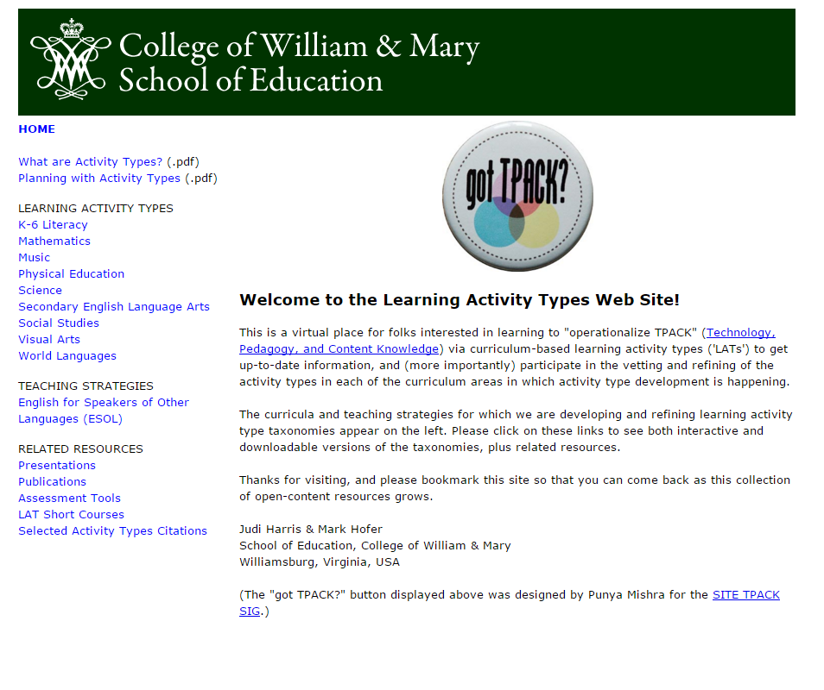
Learning Activity Types Approach
http://activitytypes.wm.edu/shortcourse

Slide 10
In this course, you will…
Analyze Examples
Practice with Taxonomies
Plan Your Own
Explore Taxonomies

Slide 11
In this course, you will…
Analyze Examples
Practice with Taxonomies
Plan Your Own
Explore Taxonomies

Slide 12
In this course, you will…
Analyze Examples
Practice with Taxonomies
Plan Your Own
Explore Taxonomies

Slide 13
In this course, you will…
Analyze Examples
Practice with Taxonomies
Plan Your Own
Explore Taxonomies

Slide 14
In this course, you will…
Analyze Examples
Practice with Taxonomies
Plan Your Own
Explore Taxonomies

Slide 15
Most effective?
Least effective?
Why?

