Slide 1


Instructional Planning with Learning Activity Types
Mark Hofer & Judi Harris
College of William & Mary

Slide 2

Instructional Planning with Learning Activity Types
Module 2
Identify Existing
Lessons to Explore

Slide 3
Leah Shy
Photo of Leah

Slide 4

Leah Shy

Slide 5
In this module, you will…
Analyze Examples
Practice with Taxonomies
Plan Your Own
Explore Taxonomies
Select and review three lessons.

Slide 6
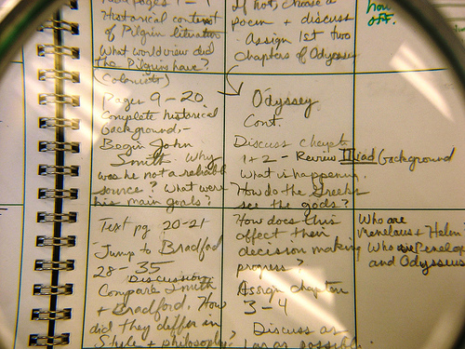

Curated Lesson Plans
LAT
Resources

Slide 7


Look for these features:
interesting
clearly explained
manageable
connected with content
single lessons

Slide 8
Identify the following attributes:
Curriculum focus/standards & learning goals
Learning activities
Assessments of students’ learning
Technologies

Slide 9


Slide 10

Annotate the three lessons.

Slide 11

Save the 3 annotated lessons.

