Slide 1


Instructional Planning with Learning Activity Types
Mark Hofer & Judi Harris
College of William & Mary

Slide 2

Instructional Planning with Learning Activity Types
Module 4
Explore Learning Activity Types Taxonomies

Slide 3
In this module, you will…
Analyze Examples
Practice with Taxonomies
Plan Your Own
Explore Taxonomies
Explore a taxonomy of learning activities with supporting technologies

Slide 4
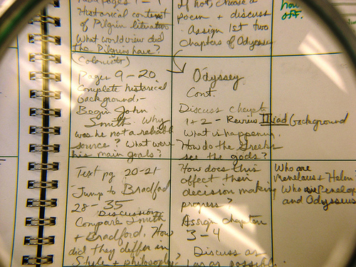
Learning Activity Preferences
appealing
enjoyed as students
successful
personal preference
limiting!

Slide 5


Slide 6


Learning Activity Types
K-6 Literacy
Mathematics
Music
Physical Education
Science
Secondary English Language Arts
Social Studies
Visual Arts
World Languages
LAT
Resources
http://activitytypes.wm.edu

Slide 7

Explore a taxonomy
Insert screencast video
overviewing science
taxonomy here.

Slide 8
Explore a taxonomy

Slide 9
Explore a taxonomy: Steps
Download the Taxonomy Exploration Guide.
Read the intro and skim headings.
Read through the LATs.
List familiar LATs.
Note probable LATs for use.
Note promising LATs.

