Slide 1


Instructional Planning with Learning Activity Types
Mark Hofer & Judi Harris
College of William & Mary

Slide 2

Instructional Planning with Learning Activity Types
Module 5
Practice Using the Taxonomies

Slide 3
In this module, you will…
Analyze Examples
Practice with Taxonomies
Plan Your Own
Explore Taxonomies
Become more familiar with using the taxonomies by modifying existing lessons.

Slide 4
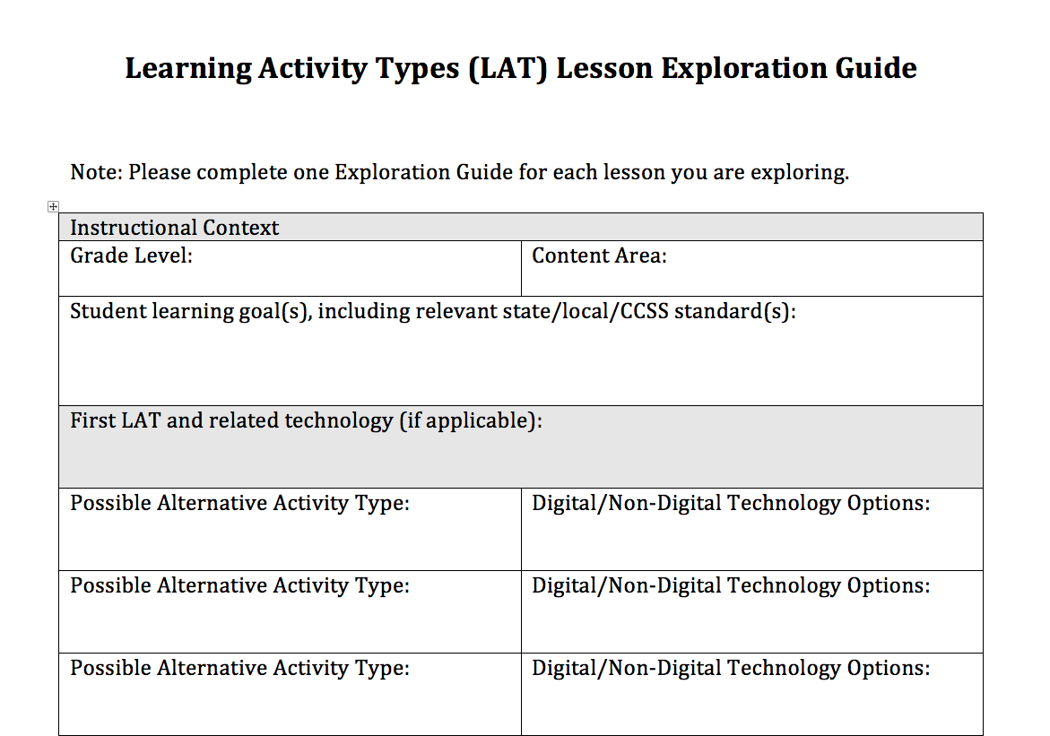
Lesson Exploration Guide

Slide 5
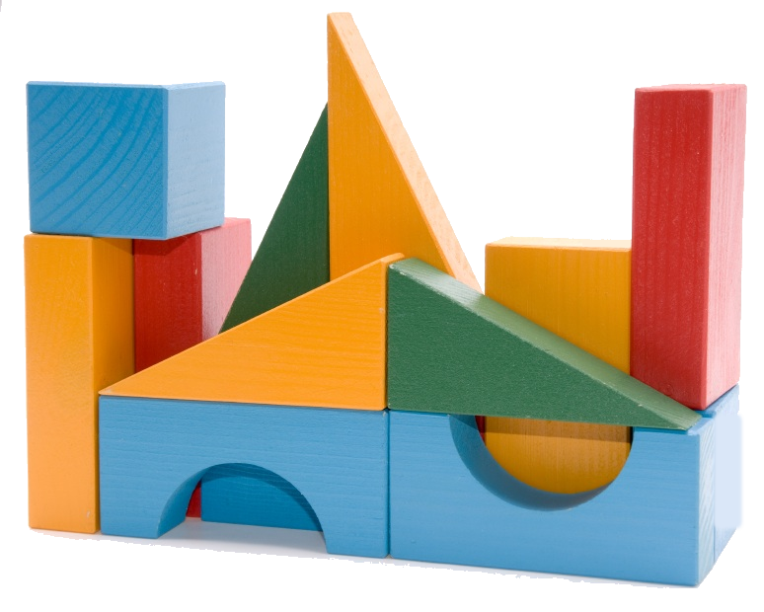
Identify existing LATs
Label each LAT
Identify technologies
used

