Slide 2
Identify Taxonomy Sub-Headings
Identify relevant taxonomy.
Scan the sub-categories.
Determine relevant sub-categories.

Slide 3
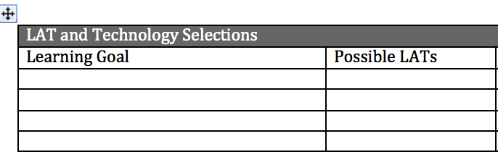
Select LATs
For each goal, identify 1-3 LATs

Slide 4
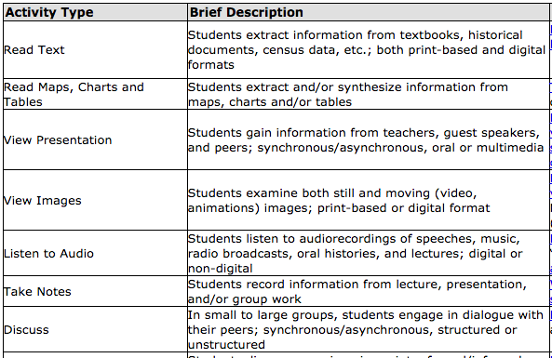
“Identify the purposes and key features
of the 13 original American colonies.”

Slide 5
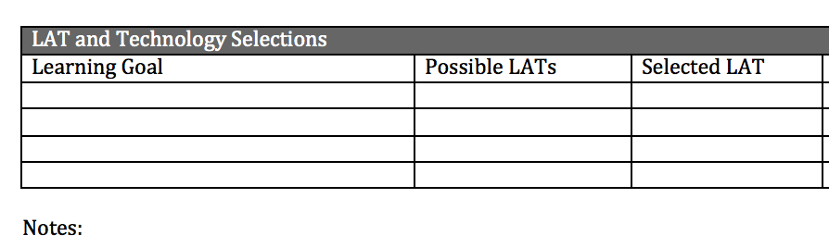
Determine the Best “Fit”
Combine LATs to address one goal?
Address multiple goals with one LAT?

Slide 7
